Slide 1

U08784
Software Configuration Management
Configuration Management plan
Configuration items
Version control
Build management
Release procedures
Change control
Traceability
Tool support
SCM standards
Disaster recovery
Software Documentation
U08784 – C Cox
School of Technology
Notes:
U08784
C Cox

Slide 2
Software Configuration Management - Overview
SCM is concerned with managing all system software and documentation components for a projects; in particular version and configuration control
Integral part of a project documentation:
  Quality plan
  Project plan
  Configuration Management plan
  Technical documents: specification, design etc
Integral part of SQA procedures so concerned about product quality
SCM in an organisation should take an integrated approach
U08784 – C Cox
School of Technology
Notes:
U08784
C Cox

Slide 3
Symptoms of Poor Software Configuration Management
Bugs that have been corrected reappear
Previous releases of software cannot be rebuilt
Previous releases of software cannot be found
Files get lost
Files are “mysteriously” changed
The same or similar code exists multiple times in different projects
Two developers independently change the same file concurrently
U08784 – C Cox
School of Technology
Notes:
U08784
C Cox

Slide 4
Reasons for needing Configuration Management
New versions of software for
Providing different (bug fixed/enhanced) functionality
Evolving software systems subject to change requests from users, developers and market forces
Software to run on different machines/OS
Multiple versions of the same software need to be supported
Changes to business, technical or user requirements
Why Important
allow multiple developers to work on software that is evolving
Control the evolution of software products
Ensure required changes occur
Reporting changes to others
System changes involve a project team
Ensure previous releases of software can be rebuilt
Cannot afford inconsistencies to occur
Must keep track of these changes
Disaster recovery
QA requirement
U08784 – C Cox
School of Technology
Notes:
U08784
C Cox

Slide 5
1 Configuration Management Plan
Defines:
The types of document to be managed
Who takes responsibility for configuration management activities
Policies for change control and version management
The CM records that must be maintained
The tools to be used
The database of configuration items
What metrics used to measure progress
U08784 – C Cox
School of Technology
Notes:
U08784
C Cox

Slide 6
Configuration Management Plan - detail
Introduction
Definition of project: client requirements, deliverables, timescales, cost
Project team structure: responsibilities, sub-contractors
Project plan: development stages, individual tasks
Related documents: quality plans
Configuration items (section 2)
Configuration control (version control, section 3)
Configuration audit procedures (section 7)
U08784 – C Cox
School of Technology
Notes:
U08784
C Cox

Slide 7
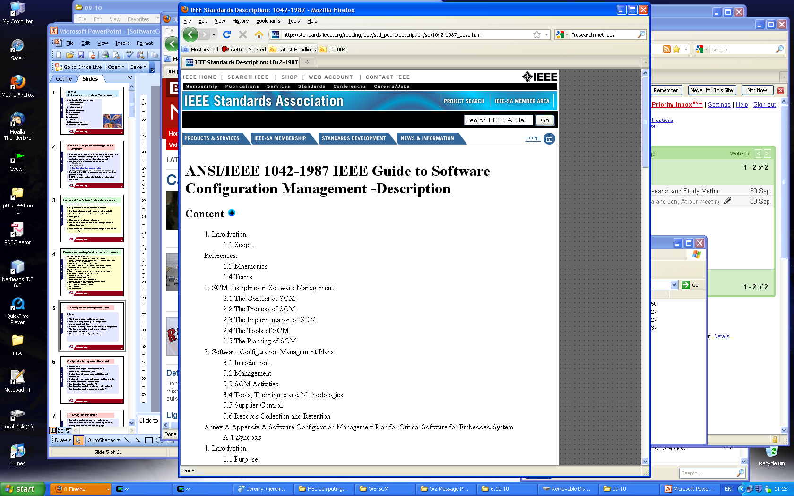
U08784 – C Cox
IEEE 1042 Guide to Software Configuration Management
School of Technology

Slide 8
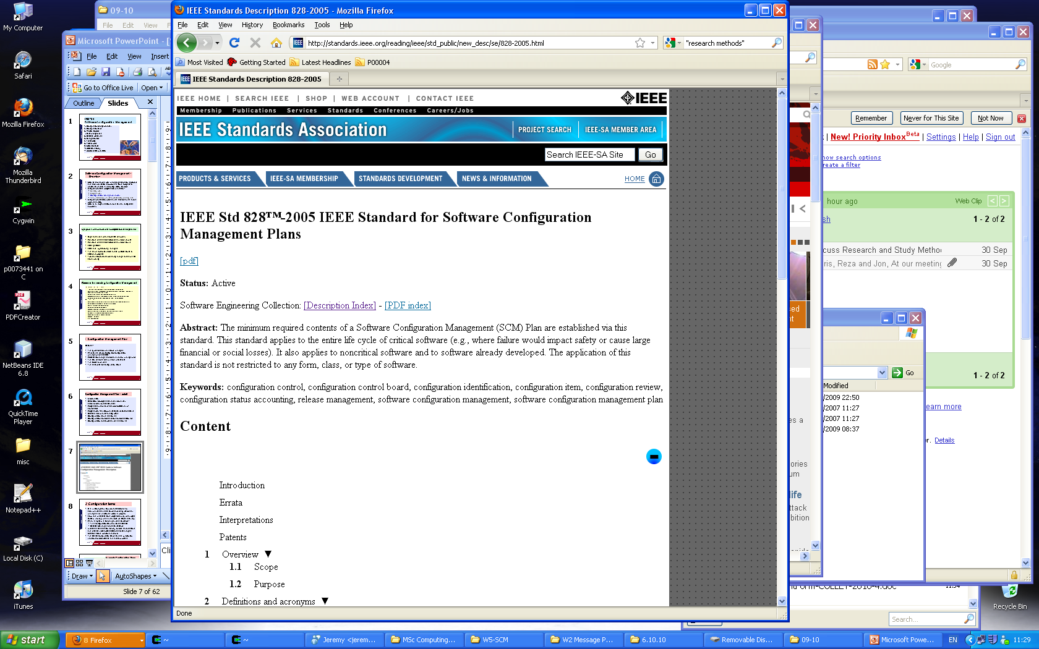
U08784 – C Cox
IEEE 828 Standard for Software Configuration Management Plans
School of Technology

Slide 9
2 Configuration Items
Is a unit or system component (software or document) that needs to be separately recorded, managed and versioned within a project.
Form the metadata for a project, so may be subject to item naming rules and should be stored securely
When a system is to change, need to record:
  The configuration items involves/affected
  Details of change to individual items
A release (see section 5) may involve several items and release notes will detail the actual changes (relative to the previous version).
The list of configuration items is used by SQA for version control, release and audit purposes
U08784 – C Cox
School of Technology
Notes:
U08784
C Cox

Slide 10
Example Configuration items
Document items
Project contract
Project plan
Configuration management plan
Requirements specification
Design specification
Test plan, test data
Users guide
Installation guide
Source code listing
Maintenance (change requests)
  Enhancement requests
  Bug reports
Etc.
U08784 – C Cox
Software items
Source code
Libraries
Database schemas
Test data
Build procedures:
Etc.
School of Technology
Notes:
U08784
C Cox

Slide 11
3 Version Control
Versions represent the customer view of a system evolution
Need to identify and keep track of the different versions of a system
Important to archive each version securely (free from loss or change) to be able to regenerate any previous version exactly
A new version is defined when changes (e.g. new functionality) has been completed. The changes, and hence the version number can be major or minor.
U08784 – C Cox
School of Technology

Slide 12
Versions
Version can reflect: bug fixes, new features, performance improvements, extend portability etc.
Pre release (prototype) versions can be numbered 0.1, 0.2 etc
The first major version is 1.0
Minor versions of this will be 1.1, 1.2, .. Etc.
The next major release will be 2.0, etc.
Beta release versions, e.g. 3.2x
Each release is defined by the version id of each configuration item forming part of the system and the composition of these items.
Important to archive each version securely (safe from loss or change) to be able to regenerate any previous version exactly
U08784 – C Cox
School of Technology

Slide 13
Versions
Example
Initial System
Sun version
HP version
PC version
Windows version
Desktop version
Server version
Linux version
. . . . .
U08784 – C Cox
School of Technology

Slide 14
Variants
A variant of a version is generated to customise a system for a specific implementation
Variants relate to different instances of a system having identical functionality but different non functional requirements
E.g. MS Office applications can be customised to a particular printer (driver), so MS Word may fail with print driver X but work ok with driver Y
Version and Variant ID example
A system release v2.6 consists of components 1,2,3,4,5
Component 4 is used for a colour display
Component 5 is used for monochrome display
So a colour variant, say v2.6C, uses components {1,2,3,4}
While monochrome variant, say v2.6M, uses {1,2,3,5}
U08784 – C Cox
School of Technology

Slide 15
Release
Instance of a system that is distributed to users outside the development team
Generally incorporated bug fixes and enhancement requests from users/customers
Release planning is used to determine when to issue a version as a release
Difference in functionality and operation specified in release notes
Is associated with a formal release procedure (see later)
U08784 – C Cox
School of Technology

Slide 16
Why Version control
Store and retrieve multiple versions of files
Maintain history of changes
Allow you to revert reliably to any previous version
Resolve access conflicts – protection against multiple editing/update (special hazard with shared documents)
Control release and record each version status
Reduce file storage
U08784 – C Cox
School of Technology

Slide 17
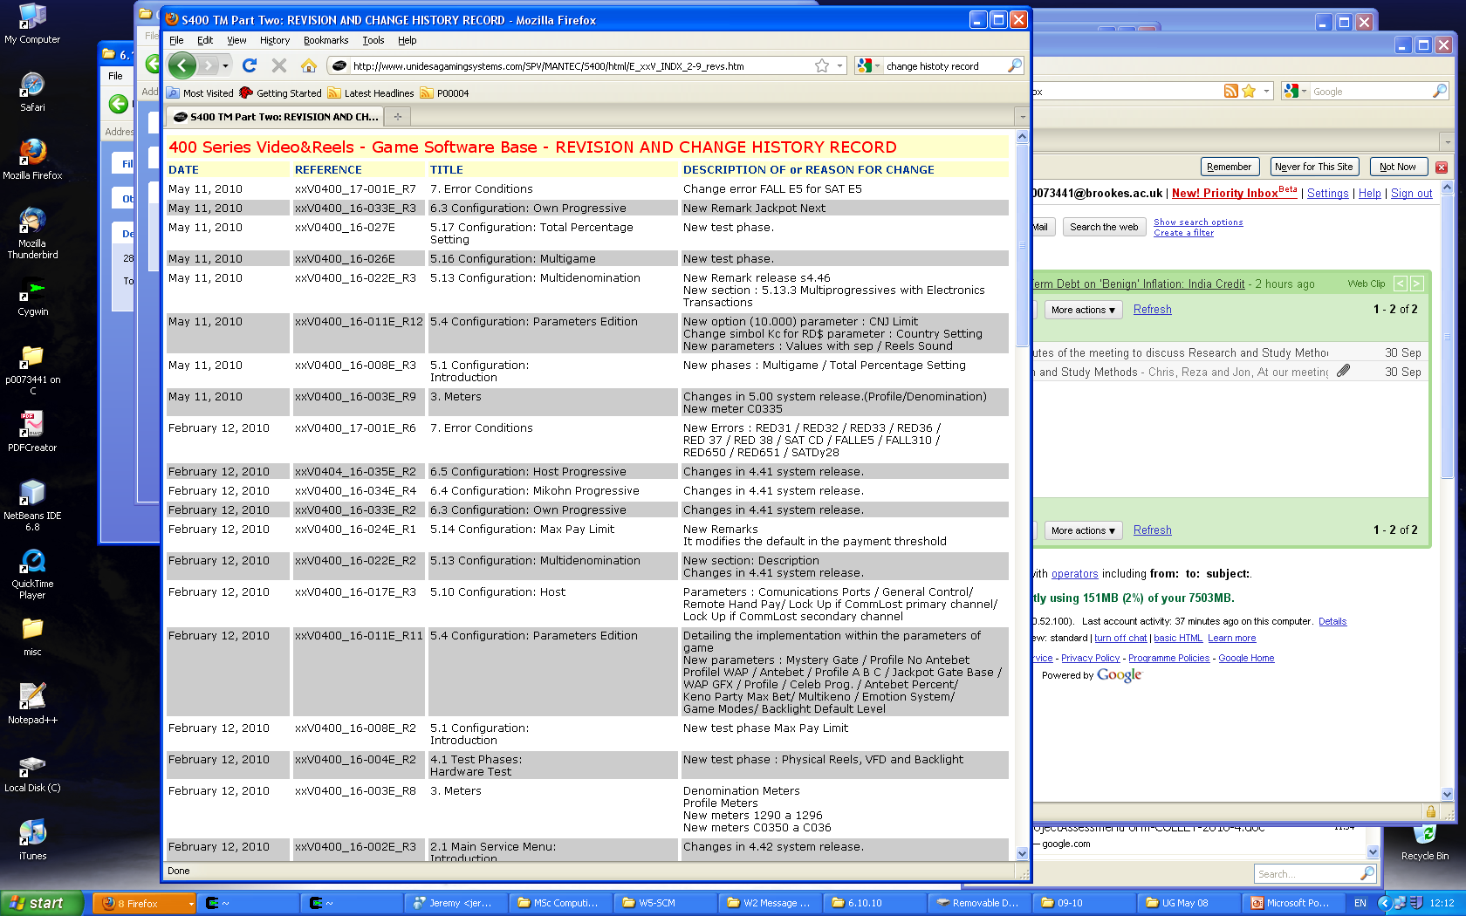
Document History Record
Record of the changes to a document or source code
Who, when, what, why changes, rationale for change
May be free format comments, or structured for automatic processing
U08784 – C Cox
School of Technology

Slide 18
Version control tools –
RCS (Revision Control Software)
Unix based, circa 1980, based on earlier SCCS, note now superseded by CVS, Subversion etc
Manage multiple revisions of files and for file sharing with others
Freely available, now part of gnu - download from gnu.org, but its standard with most Unix/Linux installations
Easy to set up (just create RCS directiory), also it works with make
OK with single machine single user, care needed with multi users
Help from gnu or man {rcsintro, rcs, ci, co, rcsdiff, rlog etc}
Commands: ci check in
        co check out
Manually enter change log: who, when, where etc
Automatic code insertion:
  $Id$ in source code is replaced by autogenerated rcs version number string
  E.g. In C code declare static char rscid[]=“$Id$”;
  $log$ in source file replaced by manually entered rcs log entry
U08784 – C Cox
School of Technology

Slide 19
RCS – example session
$ ls
hello.c
$ mkdir RCS
$ ci hello.c
RCS/hello.c,v <-- hello.c
enter description, terminated with single '.' or end of file:
NOTE: This is NOT the log message!
>> initial version 1.0
>> .
initial revision: 1.1
done
$ ls -alt
total 0
drwxr-xr-x 1 chris mkgroup 0 Nov 2 11:30 .
drwxr-xr-x 1 chris mkgroup 0 Nov 2 11:30 RCS
drwxr-xr-x 1 chris mkgroup 0 Nov 2 11:27 ..
$ rlog hello.c
RCS file: RCS/hello.c,v
Working file: hello.c
head: 1.1
branch:
locks: strict
access list:
symbolic names:
keyword substitution: kv
total revisions: 1; selected revisions: 1
description:
initial version 1.0
----------------------------
revision 1.1
date: 2006/11/02 11:29:55; author: chris; state: Exp;
Initial revision
==============================================
$ co prog.c
co: RCS/prog.c,v: No such file or directory
$ co hello.c
RCS/hello.c,v --> hello.c
revision 1.1
done
$ ls -alt
total 1
drwxr-xr-x 1 chris mkgroup 0 Nov 2 11:31 .
-r--r--r-- 1 chris mkgroup 124 Nov 2 11:31 hello.c
drwxr-xr-x 1 chris mkgroup 0 Nov 2 11:30 RCS
drwxr-xr-x 1 chris mkgroup 0 Nov 2 11:27 ..
$ chmod 600 hello.c
$ ls -alt
total 1
drwxr-xr-x 1 chris mkgroup 0 Nov 2 11:31 .
-rw-r--r-- 1 chris mkgroup 124 Nov 2 11:31 hello.c
drwxr-xr-x 1 chris mkgroup 0 Nov 2 11:30 RCS
drwxr-xr-x 1 chris mkgroup 0 Nov 2 11:27 ..
$ ls -alt
total 1
-rw-r--r-- 1 chris mkgroup 78 Nov 2 11:32 hello.c
drwxr-xr-x 1 chris mkgroup 0 Nov 2 11:31 .
drwxr-xr-x 1 chris mkgroup 0 Nov 2 11:30 RCS
drwxr-xr-x 1 chris mkgroup 0 Nov 2 11:27 ..
$ ci hello.c
RCS/hello.c,v <-- hello.c
ci: RCS/hello.c,v: no lock set by chris
$ ls -alt
total 1
drwxr-xr-x 1 chris mkgroup 0 Nov 2 11:33 RCS
-rw-r--r-- 1 chris mkgroup 78 Nov 2 11:32 hello.c
drwxr-xr-x 1 chris mkgroup 0 Nov 2 11:31 .
drwxr-xr-x 1 chris mkgroup 0 Nov 2 11:27 ..
$ rcsdiff hello.c
===================================================
RCS file: RCS/hello.c,v
retrieving revision 1.1
diff -r1.1 hello.c
4,5c4
< { char c1,c2,c3,c4,c5;
< scanf("%d%d%d%d%d",&c1,&c2,&c3,&c4,&c5);
---
> { printf("hello\n");
U08784 – C Cox
School of Technology

Slide 20
RCS – example session
$ ls
hello.c
$ mkdir RCS
$ ci hello.c
RCS/hello.c,v <-- hello.c
enter description, terminated with single '.' or end of file:
NOTE: This is NOT the log message!
>> initial version 1.0
>> .
initial revision: 1.1
done
$ ls -alt
total 0
drwxr-xr-x 1 chris mkgroup 0 Nov 2 11:30 .
drwxr-xr-x 1 chris mkgroup 0 Nov 2 11:30 RCS
drwxr-xr-x 1 chris mkgroup 0 Nov 2 11:27 ..
$ rlog hello.c
RCS file: RCS/hello.c,v
Working file: hello.c
head: 1.1
branch:
locks: strict
access list:
symbolic names:
keyword substitution: kv
total revisions: 1; selected revisions: 1
description:
initial version 1.0
----------------------------
revision 1.1
date: 2006/11/02 11:29:55; author: chris; state: Exp;
Initial revision
==============================================
$ co prog.c
co: RCS/prog.c,v: No such file or directory
$ co hello.c
RCS/hello.c,v --> hello.c
revision 1.1
done
$ ls -alt
total 1
drwxr-xr-x 1 chris mkgroup 0 Nov 2 11:31 .
-r--r--r-- 1 chris mkgroup 124 Nov 2 11:31 hello.c
drwxr-xr-x 1 chris mkgroup 0 Nov 2 11:30 RCS
drwxr-xr-x 1 chris mkgroup 0 Nov 2 11:27 ..
$ chmod 600 hello.c
$ ls -alt
total 1
drwxr-xr-x 1 chris mkgroup 0 Nov 2 11:31 .
-rw-r--r-- 1 chris mkgroup 124 Nov 2 11:31 hello.c
drwxr-xr-x 1 chris mkgroup 0 Nov 2 11:30 RCS
drwxr-xr-x 1 chris mkgroup 0 Nov 2 11:27 ..
$ ls -alt
total 1
-rw-r--r-- 1 chris mkgroup 78 Nov 2 11:32 hello.c
drwxr-xr-x 1 chris mkgroup 0 Nov 2 11:31 .
drwxr-xr-x 1 chris mkgroup 0 Nov 2 11:30 RCS
drwxr-xr-x 1 chris mkgroup 0 Nov 2 11:27 ..
$ ci hello.c
RCS/hello.c,v <-- hello.c
ci: RCS/hello.c,v: no lock set by chris
$ ls -alt
total 1
drwxr-xr-x 1 chris mkgroup 0 Nov 2 11:33 RCS
-rw-r--r-- 1 chris mkgroup 78 Nov 2 11:32 hello.c
drwxr-xr-x 1 chris mkgroup 0 Nov 2 11:31 .
drwxr-xr-x 1 chris mkgroup 0 Nov 2 11:27 ..
$ rcsdiff hello.c
===================================================
RCS file: RCS/hello.c,v
retrieving revision 1.1
diff -r1.1 hello.c
4,5c4
< { char c1,c2,c3,c4,c5;
< scanf("%d%d%d%d%d",&c1,&c2,&c3,&c4,&c5);
---
> { printf("hello\n");
U08784 – C Cox
School of Technology

Slide 21
CVS – Concurrent Version System (cvshome.org)
Unix, Linux, Windows and OS X platforms
Evolved from rcs, 1986
Widely used
Open standard for source version control
Uses client-server architecture
Server stores current project versions – keeps track of history changes for a set of files
Clients connect to check-in and check-out
Allows concurrent working by project team members
Server will only allow changes to most recent version of a file
On successful check-in version numbers are auto incremented and (client) author details recorded
Subsequent development:
DCVS – distributed version
Subversion – now replaced CVS
U08784 – C Cox
School of Technology

Slide 22
Using CVS
uses RCS
set up a CVS repository (CVS root directory)
allows multiple authors on same project
harder to set up than RCS
commands
  cvs checkout – remove file from repository
  cvs update – update own files with changes made by others
  cvs commit – add own changes to repository
  cvs delete – delete file from repository
U08784 – C Cox
School of Technology

Slide 23

Subversion
Open source revision control software for Unix, Windows, Mac OS X
Supplied by CollabNet Inc, http://subversion.tigris.org/
On line (free) documentation book http://svnbook.red-bean.com/en/1.0/svn-book.html
Is an evolution of CVS
Provides version control for files and directories
Provided ‘atomic commit’ so a collection of changes can either all go, or none at all as a single transaction
Client-server operation
Usually incorporated within the programming language IDE.
Distributed operation across a network
Safe distributed operation with atomic update – lock prevents simultaneous update be multiple users
U08784 – C Cox
School of Technology

Slide 24
Using Subversion
for help (on Unix, Linux)
  man svn
  svn help
  svnadmin help
create a repository
  svnadmin create store
add new file to a repository
  svn add newfile
checking out
  svn co file
update source
  svn update
check in changes to file
  svn commit file
examine previous checkin versions
  svn log –v version
check status of files prior to commit
  svn status
Path to repository
e.g. r3
U08784 – C Cox
Ensure that no one else is updating at same time
Auto generates version number
School of Technology

Slide 25
Perforce (www.perforce.com)
Client-server configuration management
Perforce server manages central database and file repository
Users work in local client workspaces
Server manages central repository database
Users submit changes to change lists
Widely used
Supports parallel working with common code, or multiple independent parallel threads (variants)
Good portability: Unix, Windows, Mac etc.
U08784 – C Cox
School of Technology

Slide 26
4 Build Management
Process of converting source code files into executable code
For simple (single source file) programs simply compile and link
For complex programs (multiple source files) a more complex recipe is needed as:
  Performing a complex build sequence manually is tedious and error prone
  The executable version id does not guarantee its build – so very important to maintain system integrity
  Source and object files must be compiled in the correct order
  Only changed files need be processed – so time can be saved
  Important that the latest changes are incorporated properly
Example build tools:
  Ant
  SCons
  Make
Trend is to incorporate build function into software development Integrated Design Enviroment (IDE)
U08784 – C Cox
School of Technology

Slide 27
Ant - Apache Ant (Another Neat Tool), Apache Software Foundation http://en.wikipedia.org/wiki/Apache_Ant
Similar to make, build tool designed for Java environment
Uses XML to describe the build process and file dependencies
Provides good portability for a range of platforms: Unix, Windows etc.
Limited file handling
Has: projects, targets, tasks, properties, paths
Example: build.xml file for a simple Java "Hello, world" application.
U08784 – C Cox
<?xml version="1.0"?>
<project name="Hello" default="compile">
<target name="clean" description="remove intermediate files">
<delete dir="classes"/>
</target>
<target name="compile"
description="compile the Java source code to class files">
<mkdir dir="classes"/>
<javac srcdir="." destdir="classes"/>
</target>
<target name="jar" depends="compile“
description="create a Jar file for the application">
<jar destfile="hello.jar">
<fileset dir="classes" includes="**/*.class"/>
<manifest>
<attribute name="Main-Class" value="HelloProgram"/>
</manifest>
</jar>
</target>
</project>
School of Technology

Slide 28
SCons (Steven Knight, www.SCons.org )
Open source build tool
Alternative to make
Multiplatform: Unix, Windows etc.
Automatic dependency rules for C, C++ and Fortran
Built in support to use RCS or CVS etc revision control systems
.NET support
Configuration files are Python scripts
U08784 – C Cox
A sample SConscript
Program('main.c')
SCons builds the 'main' executable (on Linux) or 'main.exe' (on Windows).
School of Technology

Slide 29
Make (Orig. Steve Feldman Bell Labs 1977)
Most widely used build tool, particularly for C/C++ and on Unix
Is a specification language to define build instructions for a software system or project
latest variants: BSD, GNU, Microsoft, all with same basic operation
Specify file dependency and compiler instruction in a makefile
Uses last modified date to only build new components and so optimise build performance
Invaluable for large program development projects
U08784 – C Cox
Using make
Create file makefile (textfile called makefile or Makefile) to accompany the source code files
Invoke using make command (or make –f <filename>)
Invoke make whenever a change is made to the system
School of Technology

Slide 30
Example C program contained in 3 source files
cs3%cat main.c
#include "reverse.h"
main()
{ char *a, **b;
char string1[]="abcde";
char string2[80];
a = string1;
*b=string2;
reverse(a,b);
printf
("string2 is %s\n", *b);
}
cat reverse.c
#include <string.h>
void reverse(char *b,char **a)
{ char reversed[80];
char *tempb = b;
int j = 79;
reversed[j] = NULL;
while (*tempb)
{ j--;
reversed[j] = *tempb;
tempb++;
}
*a = &reversed[j];
}
U08784 – C Cox
cat reverse.h
void reverse();
School of Technology

Slide 31
Compiling manually
reverse.c
void reverse(int b,int a);
{...
}
to compile
gcc -c reverse.c –o reverse.o
now have object module reverse.o
reverse.h
void reverse() ;
main.c
#include "reverse.h"
main ()
{...
reverse(a,b);
}
to compile -
gcc -c main.c –o main.o
now have 2 object modules
reverse.o main.o
finally build executable from objects
gcc reverse.o main.o -o main
U08784 – C Cox
School of Technology
Notes:
U08784
C Cox

Slide 32
Make used a dependency tree. Then looks at last modified
file dates to see which commands must be executed.
main
main.o reverse.o
U08784 – C Cox
main.c reverse.h reverse.c
School of Technology
Notes:
U08784
C Cox

Slide 33
A basic makefile
main: main.o reverse.o
gcc main.o reverse.o -o main
main.o: main.c reverse.h
gcc -c main.c -o main.o
reverse.o: reverse.c
gcc –c reverse.c reverse.o
U08784 – C Cox
Save these rules in a file called makefile
in the same directory as the source files.
School of Technology
Notes:
U08784
C Cox

Slide 34
A better (more generic) makefile solution
# c cox july 06
CFLAGS=-Wall
LFLAGS=-lm
CC=gcc
OBJS=main.o reverse.o
PROGRAM=main
$(PROGRAM): $(OBJS)
$(CC) $(OBJS) -o $(PROGRAM)
main.o: main.c reverse.h
$(CC) -c main.c -o main.o
reverse.o: reverse.c
$(CC) –c reverse.c reverse.o
clean:
rm $(OBJS)
U08784 – C Cox
School of Technology
Notes:
U08784
C Cox

Slide 35
Makefile format
target list: dependency list
<tab> command list
<blank line>
Colon, tabs and blank line formatting is essential
Target must start on first character of the line
The command make will automatically pick up the file makefile or Makefile , in same directory as source files
make without arguments makes the first target
make with argument makes the specified target
use make –f <filename> to use a differently named makefile
U08784 – C Cox
School of Technology
Notes:
U08784
C Cox

Slide 36
C shapes program
– using functions
/* c.cox 27.2.01 file: shapes.c shapes program with
functions in separate source files */
#include <stdio.h>
#define Circle 'C'
float circle(void); /* circle area prototype */
/* float rectangle(void); */ /* rectangle area prototype */
/* float square(void); */ /* square area prototype */
main()
{ char shape;
float area;
printf("Enter shape, C=circle, R=rectangle, S=square: ");
scanf("%c", &shape);
if(shape==Circle) area = circle();
/* if(shape=='R') area = rectangle(); */
/* if(shape=='S') area = square(); */
printf("Area of shape = %f\n", area);
}
U08784 – C Cox
/* c.cox 27.2.01 file: circle.c
shapes programs using functions */
#define pi 3.1415926
#include <stdio.h>
float circle(void) /* circle area function */
{ float radius;
float area;
printf(“enter circle radius: “);
scanf(“%f”, &radius);
area = pi*radius*radius;
return area;
}
School of Technology

Slide 37
Running the makefile for the Shapes program
$ cat makefile
# c.cox 28.2.01 makefile for shapes program
CC = gcc
OBJS = shapes.o circle.o
Shapes: $(OBJS)
$(CC) –o shapes $(OBJS)
shapes.o: shapes.c
$(CC) –c shapes.c
circle.o: circle.c
$(CC) –c circle.c
$ make
gcc -c shapes.c
gcc -c circle.c
gcc -o shapes shapes.o circle.o
$ shapes
Enter shape, C=circle, R=rectangle, S=square: C
enter circle radius: 3.5
Area of shape = 38.484509
$
U08784 – C Cox
School of Technology

Slide 38
5 Software Release Procedures
Purpose:
Clarify purpose of release (new product, enhancement, bug fix etc)
Verify integrity and quality of delivered software products (tested software, signed off checks for development documents)
Ensure SQA procedures followed correctly
Assign (unique) version number
Prepare configuration items required for customer delivery
Ensure correct version of all issued software components
Archive copies of all software versions
U08784 – C Cox
Performed by Quality Control
School of Technology

Slide 39
Software Release
Deliverables include:
Executable code
Configuration files
Data files
Installation procedures
Documentation in electronic and/or paper form
Supplied as CD/DVD or web download
U08784 – C Cox
School of Technology

Slide 40
Software Release Procedures
– performed by SQA on a Software Release Form (SRF)
Collect copy of configurable items for the new release into a separate QA directory
Determine which configuration items are for customer release, which are for internal use
Clarify and record purpose of release, e.g. new product, enhancement, bug fix etc.
Assign new version number to new software product
SQA documentation check:
  Confirm signed off checks for project deliverables: contract, requirement spec, design spec, source code, users guide, etc.
  Source code checks: determine complexity metrics, source code meets agreed standard, etc.
System build: SQA to follow build instructions to generate required executables (user executable + test harnesses etc.)
Testing, SQA to perform:
  Verification testing (exhaustive tests in simulated environment to include module, integration and regression testing), then confirms that test results agree with supplied test plan
  Validation testing, testing in a real environment (generally as acceptance testing), and to ensure version numbers on executables are correct
SQA to make safe archive copies of all configuration items
SQA to approve and sign off complete SRF for all internal checks
Copy executables and agreed customer deliverables to required media (CD, web server, etc.) for distribution
Issue software to customer
U08784 – C Cox
School of Technology

Slide 41
Software Testing – usually a key component of software release
Static tests
Code complexity metrics
Source code meets agreed standards
Dynamic tests
Verification testing – e.g. regression testing, confirming test results agree with test plan
Validation testing – test in real environment, e.g. acceptance testing
U08784 – C Cox
School of Technology

Slide 42
6 Change Control
Prevents ad hoc, informal or unintended software modifications
Provides an audit trail of a configuration item or software system development history
Procedure
Receive change request from user/customer
Produce technical and cost analysis change report
Perform Impact Analysis
Change control authority decides
If reject then
  Inform requestor
Else {accept to incorporate change}
  Determine affected code and documentation etc. items
  Make changes and incorporate into system
  Write release notes
  Release product incorporating the change
  Inform and supply requestor with new version
U08784 – C Cox
School of Technology

Slide 43
Change Request (or Change Proposal) Form
Record the proposed change
Requester
Reason
Urgency for requester
Record the change evolution (reviewed by Change Control Board)
Impact Analysis
Change cost and recommendations
U08784 – C Cox
School of Technology

Slide 44
Impact Analysis
Configuration items affected
Impact on project cost, schedule, deliverables and resources
Risk associated with implementing the change
Risk associated with not implementing the change
U08784 – C Cox
School of Technology

Slide 45
Change Request Form - detail
Requester
CRF number
Project/program
Name
Requested change
Date
Change Analyser
Name
Analysis date
Components affected
Associated components
Change assessment
Change priority
Estimated effort
Date of CCB
Change Control Board
Decision date
Decision
Change implementer
Date of change
QC approval
comments
U08784 – C Cox
School of Technology

Slide 46
Change Control Board
Group responsible for reviewing proposed changes
Should be independent of the project development team
Customer representative
Decide on strategic, organisational as well as technical viewpoints
May include representative from client or contractor staff
U08784 – C Cox
School of Technology

Slide 47
7 Traceability
Ability to record development decisions and changes to allow rationale for development approach to be related to earlier work (e.g. test cases based on requirements and each use case, and possible scenario within, is tested by at least 1 test case)
Formally reflects that earlier development forms dependency for later stages
Traceability matrix relates user needs to provided system features – and so potentially simplifies software maintenance
Provides project progress visibility
Provides sense of accountability
U08784 – C Cox
School of Technology

Slide 48
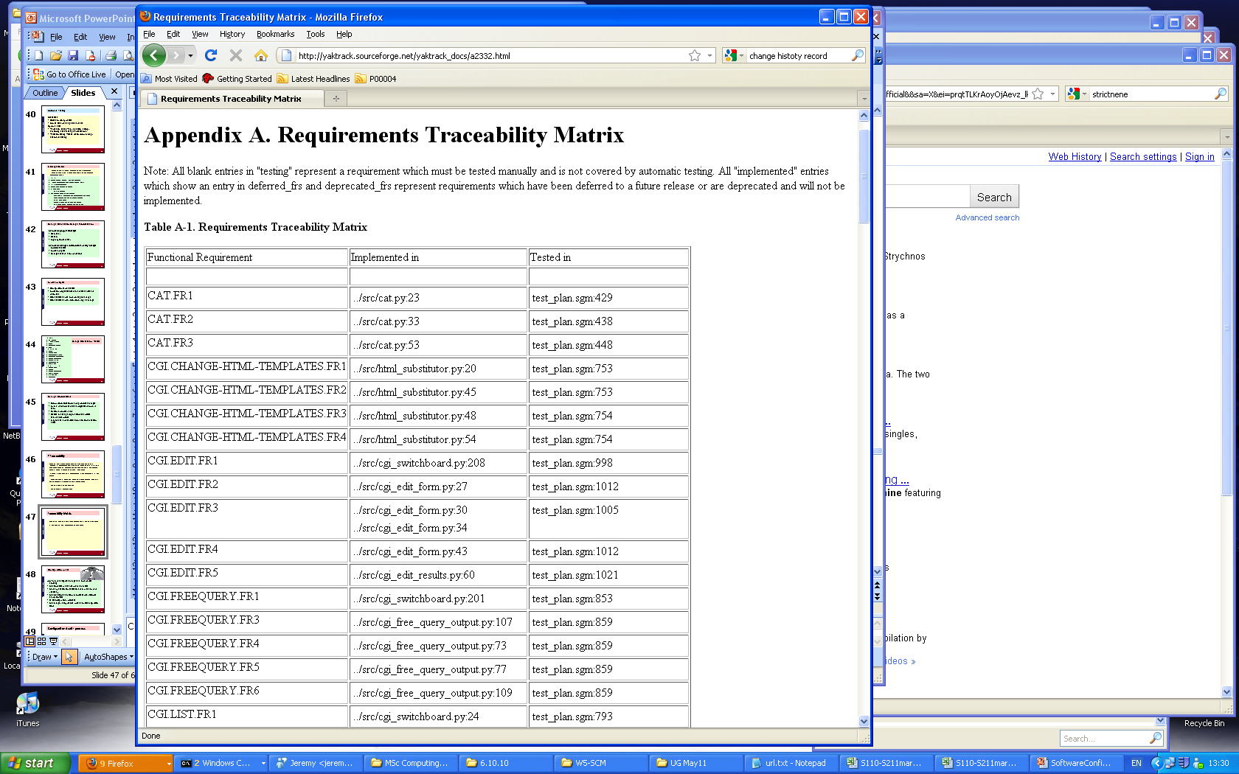
Traceability Matrix
Used to correlate different project documents or configurartion items
Often used to relate requirements to test cases
U08784 – C Cox
School of Technology

Slide 49
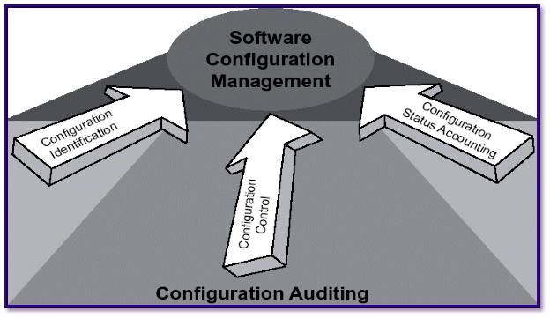
Configuration Audit
Aim: Ensure that agreed changes are implemented correctly
Has formal technical review been conducted
Have any additional modifications been made or were necessary
Has the software development process been followed as per QA/QC
Is tracebility matrix up to date
Has change history records updated on all configuration items
U08784 – C Cox
School of Technology

Slide 50
Configuration Audit - process
Verify project SQA records and software release form integrity and accuracy by random sampling of procedures and records
Formal technical review process is used to internally verify SQA configuration management procedures and records
Require development evolution history (changes and versions) traceability of each configuration item and software product
Ensure changes requested in change requests been achieved, e.g. view testing results
U08784 – C Cox
School of Technology

Slide 51
8 Software Configuration Management Tools
• RCS: very old version control but still in use
• CVS: (Concurrent Version Control) based on RCS, allows concurrent working without locking http://www.cvshome.org/
• Perforce Repository server; keeps track of developer’s activities http://www.perforce.com
• ClearCase Multiple servers, process modeling, policy check mechanisms
http://www.rational.com/products/clearcase/
• Subversion: Open Source Project (http://subversion.tigris.org/) Based on CVS
Subversion interface and features similar to CVS. Commands: checkout, add, delete, commit, diff. Differences to CVS
• Version controlled moving, renaming and copying of files and directories
• Version controlled metadata of files and directories
• Server Options
• Standalone installation
• Integrated into the Apache webserver
• The time for branch management is independent of the size of the system (unlike CVS, which creates physical copies of the files, Subversion uses only tags)
Bug Tracking: Bugzilla, Rational Clear Quest
U08784 – C Cox
School of Technology

Slide 52
9 Software Configuration Management - Standards
SCM should be based on a set of standards which are applied within an organisation
Standards should define how items are identified,how changes are controlled and how new versions are managed
Standards may be based on external CM standards:
  IEEE standards are recommended
  IEEE Standard for Software Configuration Management
  Plans, IEEE Std 828-1998
  IEEE Guide to Software Configuration Management, IEEE
  Std 1042-1987
Standard protocols from version control tools (e.g. RCS) allow use by editors, IDE’s and CASE tools.
U08784 – C Cox
School of Technology

Slide 53
Software Configuration Management Standard: IEEE Std 828
Introduction - Describes the Plan's purpose, scope of application, key terms, and references
SCM Management - (Who?) Identifies the responsibilities and authorities for accomplishing the planned activities
SCM Activities - (What?) Identifies all activities to be performed in applying to the project
SCM Schedules - (When?) Identifies the required coordination of SCM activities with the other activities in the project
SCM Resources - (How?) Identifies tools and physical and human resources required for execution of the Plan
SCM Plan Maintenance - Identifies how the Plan will bekept current while in effect
U08784 – C Cox
School of Technology

Slide 54
10 - Disaster Recovery
Policies and procedures in place for the recovery of IT infrastructure within an organisation
Loss of data, service, equipment
Deal with human induced or natural disaster
Part of business continuity plan
Measures (disaster recovery plan)
Awareness, e.g. staff training
Prevention, e.g. fire protection, UPS, security, replication, backup, insurance etc
Detection, e.g. integrity checks, internal audit, dummy run
Correction, procedures to restore data and systems
Procedure
Risk and impact analysis (probability x impact)
Financial and business implications
Disaster recovery services can be in house or outsourced
U08784 – C Cox
School of Technology

Slide 55
11 - Types of Software Documentation
Outline Design – explain rationale for design approach
  - aimed at management
  - used for project proposals, to justify funding
Technical
  - requirements, design, implementation etc.
  document the design process:
  - QA requirements
U08784 – C Cox
User
  - installation, operation, tutorial and support.
Marketing
  advertise products
  inform potential users/customers
  to place product in the marketplace
School of Technology
Notes:
U08784
C Cox
References
Britton, C and Doake, J (2003) Software Systems Development, McGraw Hill
Pressman, R (1992) Software Engineering – A practicioners approach, McGraw Hill
Bennett, McRobb and Farmer (2002) Object Oriented Ststems Analysis and Design Using UML, McGraw Hill
Ince, D (1994) ISO 900-1 and Software Quality Assurance, McGraw Hill

Slide 56
Standard Document Templates:
Requirement Specification
Design Specification
Users Guide
Program Source Code
Software Reference
U08784 – C Cox
Based on:
Plessey Research (Caswell Ltd),
CAD Software Standards
School of Technology
Notes:
U08784
C Cox
2
Documentation is the most often neglected, and most often missed, part of the system development process. When deadlines approach, the corner that is cut first is always documentation. This is unfortunate since solid documentation is essential to the overall system life cycle.

Slide 57
Requirements Specification
Title Program or System Title, Change History Record: Date, Version, Author(s), Changes,
QA Approval, Circulation, Copyright © Oxford Brookes University
I Introduction - Purpose of system, Who will use the system, Related software, Related documents
2 Feasibility - Technical, Economic, Legal, Operational, Schedule
3 Functional Requirements - Features of system, Formal specification, Method of operation,
User interface, Command language, Input and output interfaces, Parameters and Files,
Response to unexpected conditions, Dynamic performance - timing, response, throughput etc.
4 Non-Functional Requirements - Testing, validation and QA, Robustness, Accuracy, Reliability
Installation, Start up and shutdown, Portability, Security
5 Constraints - Target hardware, Environment and interface to other systems, Design methodology,
Quality standards, Target programming language, Time scales, Budget, Module testing,
Reliability, Performance, Validation, Acceptance criteria
6 Systems Analysis – e.g. UML
U08784 – C Cox
School of Technology
Notes:
U08784
C Cox
2

Slide 58
Design Specification
Title Program or System Title
Change History Record: Date, Version, Author(s), Changes, QA Approval
Circulation list
Copyright © Oxford Brookes University
Introduction
Outline of System, User Interface, Related Software, Hardware Dependencies
Programming Language, Design Constraints, Related Documents
System Design
Class diagram, Input and Output, System Structure Chart
Algorithms, Data Modelling and Data Structures, state and timing diagrams
Quality Standards, Testing, Test Plan, System Validation
Performance Criteria
Module Design
Pre and post conditions
Input and Output
Module Structure Chart
Algorithms, Data Structures
Class and State Diagrams etc. e.g. UML
Module test plan
U08784 – C Cox
School of Technology

Slide 59
Implementation – The User Guide
Program or System Title - Change History Record:Date, Version, Author(s), Changes,
QA Approval Circulation list, Copyright (C) Oxford Brookes University
Introduction - Outline of the system, What the system is used for, Who will use the system
Related documents, Related software, Software history record
Description - Procedure for starting and set-up, system requirements, installation/de-installation User Operation, System Operation, Input and Output, Formats of any files or libraries, error messages, known problems etc.
System Requirements - Hardware requirements, Operating system, Software, Libraries
Invocation - Getting started, User Interface, Command Language
Performance - Complexity behaviour:, Speed, Accuracy, Capacity, Limitations, recovery procedure
Appendices: - Installation procedure, User Commands, Error messages,
System administrator guide
U08784 – C Cox
School of Technology
Notes:
U08784
C Cox
Contains general operation details and specific reference information
The document is aimed at the non technical reader
User documentation is the second set of instructions to be written, the first being the set of instructions (the program) for the computer itself. Good user documentation is written at the technical level of the user (ideally, by the user himself) and contains procedures to operate the system. Like the program itself, user documentation needs to be tested and debugged. The closer the documentation comes to simulating the world the user sees, the better the documentation is. Screen prints and report samples should accompany procedures, with a convention established to highlight the data which the user will need to enter. When appropriate, a reference to the source of the data should be provided. If data comes from a field on a form, provide a reference to that field on the form. Good user documentation should empower the user.
Use direct language, stripped of as much jargon as possible.

Slide 60
Source Code Documentation
Essentials:
each source file (unit of program code) is self contained to include
  header: file name, change history, purpose of the code etc
  parameters and input/output
  pre and post conditions
comments to provide commentary of use of data, what is happening and other relevant information – bridge gap between problem design and code solution. Why a particular approach is taken. Invocation instructions. Changes required. Calling convention (for functions)
Explain semantics not obvious from the code
insert comments while writing the program code, not afterwards
Can mark comments for special purposes
e.g. /* *** this goes into API documentation *** */
the comments can be extracted automatically, e.g. with Unix grep
initialise variables before (read) use – don’t assume zero value
avoid use of fixed data values in code, use constants
U08784 – C Cox
School of Technology
Notes:
U08784
C Cox
single code module single purpose

Slide 61
Source Code Documentation – for self contained programs
Title Program or System Title,
Change History Record: Date, Version, Author(s), Changes, QA Approval
Circulation list, Copyright (C) OBU
Problem Statement
Description of program or system or module
Problem Analysis
Functional Requirements, Constraints, Pre an Post conditions
Operation - with examples of use
User Interface
Problem Design
Constants and Variables, Data dictionary for data structures
Module structure and organisation
Pseudo-code algorithms
Inputs, outputs
Modules/libraries used
Program Testing
Test Plan(what), Implementation (how) , results and test approval
Program Implementation
Configuration management e.g. details of make/build files
Evidence of operation – screen display etc.
U08784 – C Cox
based on: phoenixvlsi.co.uk
software standards
School of Technology
Notes:
U08784
C Cox
A useful technique whereby all the system documentation is included as comments in the source code.
Source code comments provide a record of the development of each program module

Slide 62
Software Reference Document
Introduction/overview
Change history
Technical solution approach
Systems analysis and design: requirements, design, HCI, storyboard, development methodology
Software engineering: software structure, operation, test plan
Problems encountered: unfixed bugs, missing or incomplete sections
Limitations of use: performance, data protection etc.
Suggestions for future improvements
Critical evaluation
Users guide
U08784 – C Cox
School of Technology

Slide 63
References
Roger Pressman, Software Engineering A Practitioners Approach, McGraw Hill
Ian Sommerville, Software Engineering, Addison Wesley
http://en.wikipedia.org/wiki/Configuration_management
U08784 – C Cox
School of Technology

